Slide 1

Introduction to oops

Slide 2
Procedural Programming
Procedural Programming can be defined as a programming model which is derived from structured programming, based upon the concept of calling procedure.
Procedures, also known as routines, subroutines or functions, simply consist of a series of computational steps to be carried out.
During a program’s execution, any given procedure might be called at any point, including by other procedures or itself.

Slide 3
example
FORTRAN, ALGOL, COBOL,
BASIC, Pascal and C.

Slide 4
Object-Oriented Programming
Object-oriented programming can be defined as a programming model which is based upon the concept of objects. Objects contain data in the form of attributes and code in the form of methods.
In object-oriented programming, computer programs are designed using the concept of objects that interact with the real world. Object-oriented programming languages are various but the most popular ones are class-based, meaning that objects are instances of classes, which also determine their types.

Slide 5
Languages used in Object-Oriented Programming:
Java, C++, C#, Python,
PHP, JavaScript, Ruby, Perl,
Objective-C, Dart, Swift, Scala.

Slide 6
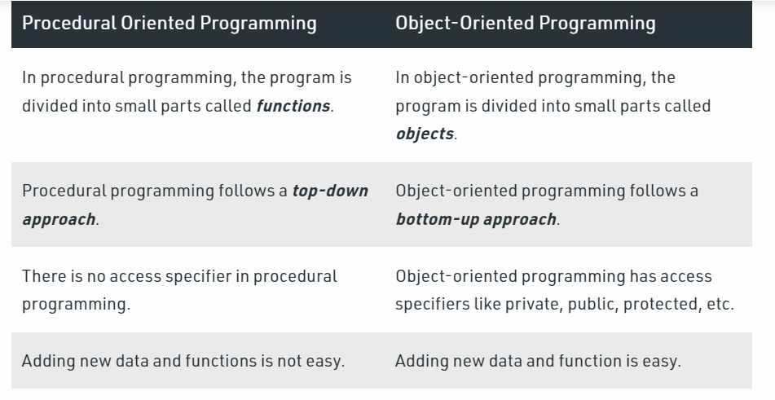

Slide 7
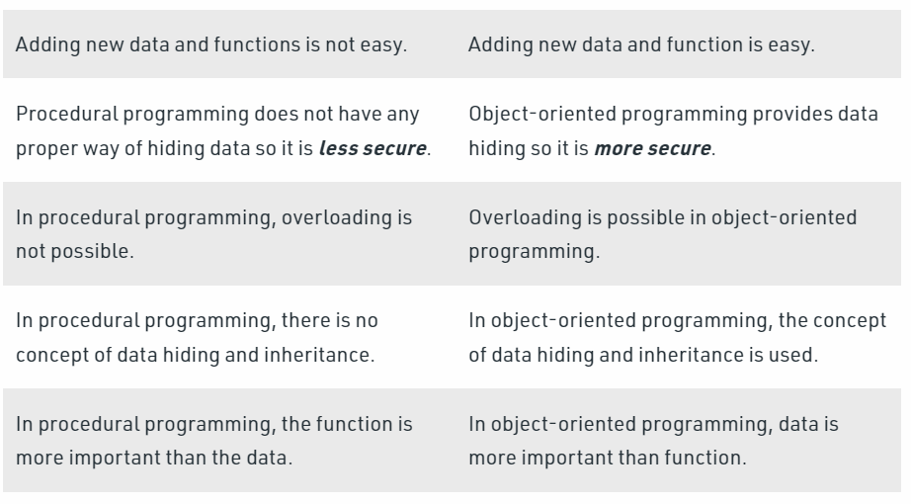

Slide 8
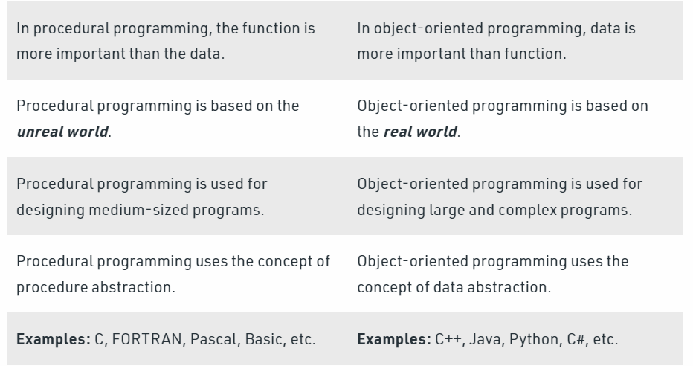

Slide 9
The Object Oriented Programming
Object-oriented programming (OOP) is a computer programming model that organizes software design around data, or objects, rather than functions and logic.
An object can be defined as a data field that has unique attributes and behavior.

Slide 10
OOP focuses on the objects that developers want to manipulate rather than the logic required to manipulate them.
This approach to programming is well-suited for programs that are large, complex and actively updated or maintained.
This includes programs for manufacturing and design, as well as mobile applications; for example, OOP can be used for manufacturing system simulation software.

Slide 11
What is the structure of object-oriented programming?
Classes are user-defined data types that act as the blueprint for individual objects, attributes and methods.
Objects are instances of a class created with specifically defined data. Objects can correspond to real-world objects or an abstract entity. When class is defined initially, the description is the only object that is defined.

Slide 12
Methods are functions that are defined inside a class that describe the behaviors of an object. Each method contained in class definitions starts with a reference to an instance object. Additionally, the subroutines contained in an object are called instance methods. Programmers use methods for reusability or keeping functionality encapsulated inside one object at a time.
Attributes are defined in the class template and represent the state of an object. Objects will have data stored in the attributes field. Class attributes belong to the class itself.

Slide 13
What are the main principles of OOP?
Encapsulation. This principle states that all important information is contained inside an object and only select information is exposed.
The implementation and state of each object are privately held inside a defined class. Other objects do not have access to this class or the authority to make changes.

Slide 14
They are only able to call a list of public functions or methods. This characteristic of data hiding provides greater program security and avoids unintended data corruption.
Abstraction. Objects only reveal internal mechanisms that are relevant for the use of other objects, hiding any unnecessary implementation code. The derived class can have its functionality extended. This concept can help developers more easily make additional changes or additions over time.

Slide 15
Inheritance. Classes can reuse code from other classes. Relationships and subclasses between objects can be assigned, enabling developers to reuse common logic while still maintaining a unique hierarchy. This property of OOP forces a more thorough data analysis, reduces development time and ensures a higher level of accuracy.

Slide 16
Polymorphism. Objects are designed to share behaviors and they can take on more than one form. The program will determine which meaning or usage is necessary for each execution of that object from a parent class, reducing the need to duplicate code. A child class is then created, which extends the functionality of the parent class. Polymorphism allows different types of objects to pass through the same interface.

